Slide 1
Chapter 4 (part 2):
Non-Parametric Classification (Sections 4.3-4.5)
Parzen Window (cont.)
Kn –Nearest Neighbor Estimation
The Nearest-Neighbor Rule

Slide 2
Parzen Windows (cont.)
Parzen Windows – Probabilistic Neural Networks
    Compute a Parzen estimate based on n patterns
      Patterns with d features sampled from c classes
      The input unit is connected to n patterns
.
.
.
.
.
W₁₁
x₁
p₁
x₂
p₂
.
.
.
.
.
.
Input unit
Input
patterns
.
.
W_{d2}
x_{d}
W_{dn}
p_{n}
Modifiable weights (trained)
Pattern Classification, Chapter 4 (Part 2)

Slide 3
.
.
p_{n}
p₁
.
p₂
.
Input
patterns
.
.
.
ω₁
.
ω₂
.
.
.
.
Category
units
p_{k}
.
.
.
.
ω_{c}
p_{n}
Activations
(Emission of nonlinear functions)
Pattern Classification, Chapter 4 (Part 2)

Slide 4
    Training the network
      Algorithm
        Normalize each pattern x of the training set to 1
        Place the first training pattern on the input units
        Set the weights linking the input units and the first pattern units such that: w₁ = x₁
        Make a single connection from the first pattern unit to the category unit corresponding to the known class of that pattern
        Repeat the process for all remaining training patterns by setting the weights such that w_{k} = x_{k} (k = 1, 2, …, n)
        We finally obtain the following network
Pattern Classification, Chapter 4 (Part 2)

Slide 5
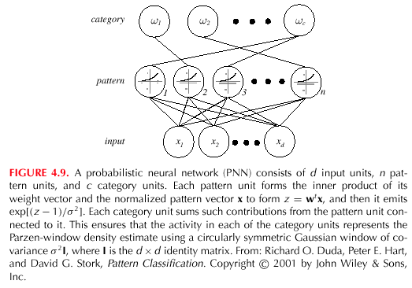
Pattern Classification, Chapter 4 (Part 2)

Slide 6
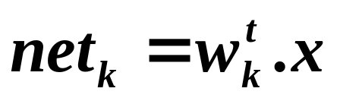
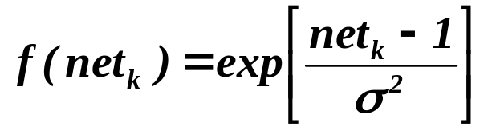
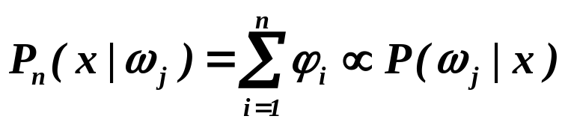
    Testing the network
      Algorithm
        Normalize the test pattern x and place it at the input units
        Each pattern unit computes the inner product in order to yield the net activation
        and emit a nonlinear function
        Each output unit sums the contributions from all pattern units connected to it
        Classify by selecting the maximum value of P_{n}(x | ω_{j})
        (j = 1, …, c)
Pattern Classification, Chapter 4 (Part 2)

Slide 7
K_{n} - Nearest neighbor density estimation
  Goal: a solution for the problem of the unknown “best” window function
    Let the cell volume be a function of the training data
    Center a cell about x and let it grows until it captures k_{n} samples
    (k_{n} = f(n))
    k_{n} denotes the k_{n} nearest-neighbors of x
  Two possibilities can occur:
    True density is high near x; therefore the cell will be small which provides a good resolution
    True density at x is low; therefore the cell will grow large and stop until higher density regions are reached
  We can obtain a family of estimates by setting k_{n}=k₁/√n and choosing different values for k₁
Pattern Classification, Chapter 4 (Part 2)

Slide 8
Illustration
  For k_{n} = √n = 1 ; the estimate becomes:
    P_{n}(x) = k_{n} / n.V_{n} = 1 / V₁ =1 / 2|x-x₁|
Pattern Classification, Chapter 4 (Part 2)

Slide 9
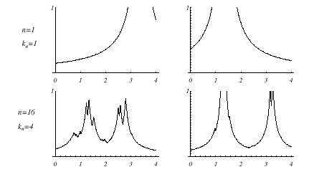
Pattern Classification, Chapter 4 (Part 2)

Slide 10
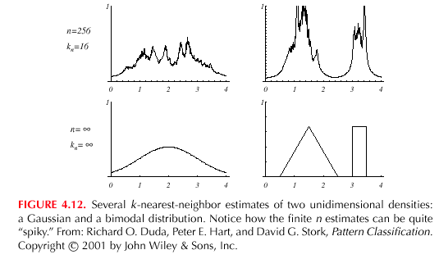
Pattern Classification, Chapter 4 (Part 2)

Slide 11
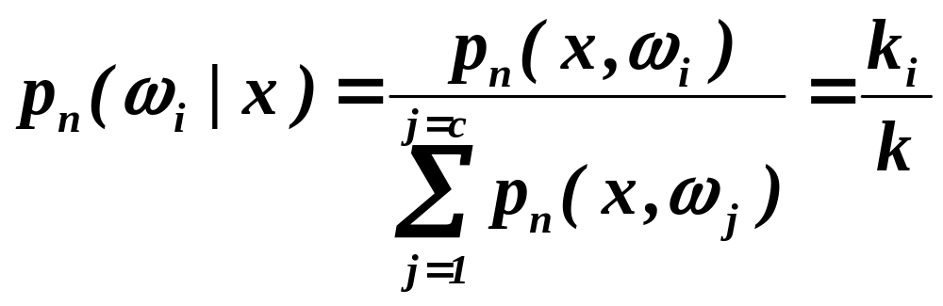
  Estimation of a-posteriori probabilities
    Goal: estimate P(ω_{i} | x) from a set of n labeled samples
      Let’s place a cell of volume V around x and capture k samples
      k_{i} samples amongst k turned out to be labeled ω_{i} then:
      p_{n}(x, ω_{i}) = k_{i} /n.V
      An estimate for p_{n}(ω_{i}| x) is:
Pattern Classification, Chapter 4 (Part 2)

Slide 12
      k_{i}/k is the fraction of the samples within the cell that are labeled ω_{i}
      For minimum error rate, the most frequently represented category within the cell is selected
      If k is large and the cell sufficiently small, the performance will approach the best possible
Pattern Classification, Chapter 4 (Part 2)

Slide 13
The nearest –neighbor decision rule
  Let D_{n} = {x₁, x₂, …, x_{n}} be a set of n labeled prototypes
  Let x’ ∈ D_{n} be the closest prototype to a test point x then the nearest-neighbor rule for classifying x is to assign it the label associated with x’
  The nearest-neighbor rule leads to an error rate greater than the minimum possible, namely the Bayes error rate
  If the number of prototypes is large (unlimited), the error rate of the nearest-neighbor classifier is never worse than twice the Bayes rate (it can be proved!)
  If n → ∞, it is always possible to find x’ sufficiently close so that:
  P(ω_{i} | x’) ≅ P(ω_{i} | x)
Pattern Classification, Chapter 4 (Part 2)

Slide 14
Example:
x = (0.68, 0.60)^{t}
^{Decision: ω}₅ ^{is the label assigned to x}
Prototypes | Labels | A-posteriori probabilities estimated
(0.50, 0.30) (0.70, 0.65) | ω₂ ω₃ ω₅ ω₆ | 0.25 0.75 = P(ω_{m} | x) 0.70 0.30
Pattern Classification, Chapter 4 (Part 2)

Slide 15
  If P(ω_{m} | x) ≅ 1, then the nearest neighbor selection is almost always the same as the Bayes selection
Pattern Classification, Chapter 4 (Part 2)

Slide 16
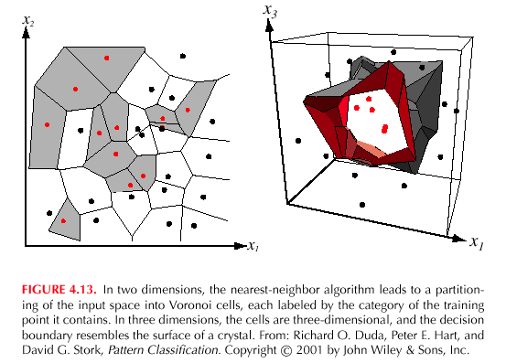
Pattern Classification, Chapter 4 (Part 2)

Slide 17
  The k – nearest-neighbor rule
    Goal: Classify x by assigning it the label most frequently represented among the k nearest samples and use a voting scheme
Pattern Classification, Chapter 4 (Part 2)

Slide 18
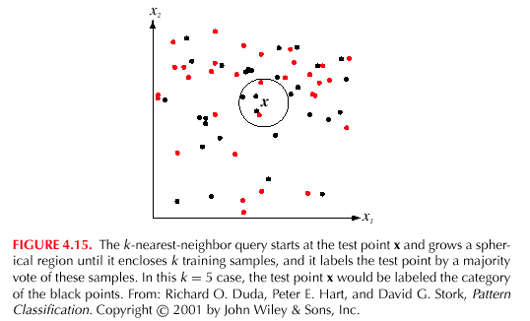
Pattern Classification, Chapter 4 (Part 2)

Slide 19
Example:
k = 3 (odd value) and x = (0.10, 0.25)^{t}
Closest vectors to x with their labels are:
{(0.10, 0.28, ω₂); (0.12, 0.20, ω₂); (0.15, 0.35,ω₁)}
One voting scheme assigns the label ω₂ to x since ω₂ is the most frequently represented
Prototypes | Labels
(0.15, 0.35) (0.10, 0.28) (0.09, 0.30) (0.12, 0.20) | ω₁ ω₂ ω₅ ω₂
Pattern Classification, Chapter 4 (Part 2)

